Slide 1
Inroduction Of Dump
Meng Yang
meyang@redhat.com
2015.12

Slide 2
Agenda
kdump
Guest memory dump
pvdump
Qemu dump

Slide 3
Kdump
Kdump is a kernel crash dumping mechanism that allows you to save the contents of the system's
memory for later analysis.
How it works
1. kexec includes 2 parts:
In kernel space: kexec_load which is used to load the second kernel into the specified memory address when the first kernel boots.
In user space: kexec_tools which will transfer the address(second kernel) to the first kernel
2. which can be used to boot a Linux kernel from the context of another kernel, bypass BIOS, and preserve the contents of the first kernel's memory that would otherwise be lost.
2. when system crash ,use kexec to boot into the second kernel and save the first kernel's memory so that we can analyse it.

Slide 4
How To Use
1.check if the package is installed.
rpm -q kexec-tools
Graphical interface package:
System-config-kdump
2.Memory reserved for the kdump kernel is always reserved during system boot
Edit /etc/grub2.cfg
…….
linux16 /vmlinuz-3.10.0-327.3.1.el7.x86_64 root=/dev/mapper/rhel_intel--e52650--16--3-root ro crashkernel=auto
…….
Change the value to a specific value
crashkernel=128M
can also set the amount of reserved memory to be variable, depending on the total amount of installed memory. The syntax is for variable memory reservation is
crashkernel=<range1>:<size1>,<range2>:<size2>.
For example:
crashkernel=512M-2G:64M,2G-:128M
Set according to the offset:
crashkernel=128M@16M

Slide 5
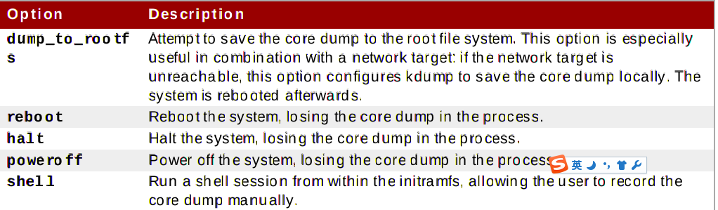
How To Use
3.configure the kdump cfg
When a kernel crash is captured, the core dump can be either stored as a file in a local file system,written directly to a device, or sent over a network using the NFS (Network File System) or SSH (SecureShell) protocol
#raw /dev/vg/lv_kdump
#ext4 /dev/vg/lv_kdump
#ext4 LABEL=/boot
#ext4 UUID=03138356-5e61-4ab3-b58e-27507ac41937
#nfs my.server.com:/export/tmp
#ssh user@my.server.com
#sshkey /root/.ssh/kdump_id_rsa
path /var/crash
core_collector makedumpfile -l --message-level 1 -d 31
#core_collector scp
4.configure the default action after coredump

Slide 6
Guest Memory Dump

Slide 7
background
virsh dump is provided as a feature for qemu/KVM guest machine to get crash dump file, which is based on migration feature of qemu. The problem is that migration to the qemu/KVM guest using PCI passthrough always fails; so virsh dump to the guest also fails. Therefore, we need to have crash dump mechanism
for qemu/KVM guest not depending on migration feature.
Without the feature, customer using PCI passthrough cannot use virsh dump command. Then, if kdump on the guest machine fails, we don't have any other way to get crash dump.

Slide 8
How to use
(qemu) ? dump-guest-memory
dump-guest-memory [-p] filename [begin] [length] -- dump guest memory to file
begin(optional): the starting physical address
length(optional): the memory size, in bytes
dump-guest-memory is a new dump mechanism, and it can work when the guest uses host devices.
"paging": do paging to get guest's memory mapping (json-bool)
"protocol": destination file(started with "file:") or destination file descriptor (started with "fd:") (json-string)
"begin": #optional if specified, the starting physical address.
"length": #optional if specified, the memory size, in bytes. If you don't want to dump all guest's memory, please specify the start begin and length.
QMP:
{"execute": "dump-guest-memory", "arguments": { "paging": false, "protocol": "file:/home/dump.normal"}}
{"execute": "dump-guest-memory", "arguments": { "paging": false, "protocol": "file:/home/dump.elf", "format": "elf"}}
{"execute":"query-dump-guest-memory-capability"}
{"return": {"formats": ["elf", "kdump-zlib", "kdump-lzo", "kdump-snappy"]}} → doesn't support paging
ZLIB -- slower, higher compression ratio (uses zlib level 3 setting, you can see the zlib level difference between 1 and 6 in zlib sources).
LZO -- faster compression and decompression than zlib, worse compression ratio, designed to be fast

Slide 9
Qemu Dump

Slide 10
Background
When a bug of guest kernel causes a failure of qemu-kvm,qemu-kvm core may be dumped to disk.
In this case, we need to investigate guest memory dump to detect the guest kernel's bug rather than investigating qemu-kvm core.
But, we can't find any feature extract guest memory dump,from qemu-kvm core in current qemu-kvm/RHEV.

Slide 11
How to use
1.
start the ABRT service, and the ccpp hook:
service abrtd start
service abrt-ccpp start
2.
Install the debuginfo package for qemu-kvm.Make sure that you have the kernel-debuginfo and kernel-debuginfo-common packages installed on the *host* that match the *guest* kernel version.
3.start the guest and kill it “pkill -SEGV -x qemu-kvm”
4.check the directory shown by the command “abrt-cli list –full”
4.open with gdb
gdb coredump
(gdb) source /usr/share/qemu-kvm/dump-guest-memory.py
(gdb) help dump-guest-memory
(gdb) set height 0
(gdb) dump-guest-memory /tmp/vmcore
5.analyze it using crash utility:
crash /usr/lib/debug/lib/modules/2.6.32-*.el6.x86_64/vmlinux /tmp/vmcore
crash> bt
crash> task 0 # returned COMMAND name should be "swapper"
crash> task 1 # returned COMMAND name should be "init"
Customers will likely start guests with virsh / virt-manager (that is, from libvirtd), and then you can't have coredumps lying around (actually, qemu probably couldn't even create a coredump, due to SELinux perms and UNIX file mode bits). So in real production the core dump must be captured by ABRT.

Slide 12
PV Dump

Slide 13
How to use
1.
start the ABRT service, and the ccpp hook:
service abrtd start
service abrt-ccpp start
2.
Install the debuginfo package for qemu-kvm.Make sure that you have the kernel-debuginfo and kernel-debuginfo-common packages installed on the *host* that match the *guest* kernel version.
3.start the guest and kill it “pkill -SEGV -x qemu-kvm”
4.check the directory shown by the command “abrt-cli list –full”
4.open with gdb
gdb coredump
(gdb) source /usr/share/qemu-kvm/dump-guest-memory.py
(gdb) help dump-guest-memory
(gdb) set height 0
(gdb) dump-guest-memory /tmp/vmcore
5.analyze it using crash utility:
crash /usr/lib/debug/lib/modules/2.6.32-*.el6.x86_64/vmlinux /tmp/vmcore
crash> bt
crash> task 0 # returned COMMAND name should be "swapper"
crash> task 1 # returned COMMAND name should be "init"
Customers will likely start guests with virsh / virt-manager (that is, from libvirtd), and then you can't have coredumps lying around (actually, qemu probably couldn't even create a coredump, due to SELinux perms and UNIX file mode bits). So in real production the core dump must be captured by ABRT.

Slide 14
PV Dump
This feature allow to support for automatic capturing and actions after capturing by "virsh dump" just like kdump.
A function which is captured a vmcore of guest OS automatically
by "virsh dump" from host OS after guest kernel panic occurs.
Functions which user can indicate these three default functions.
These functions are executed after capturing a vmcore of guest OS
using "virsh dump" from host OS and these are automatically executed.
- Reboot
- Halt
- Shutdown
Why don't just use kdump ?
- After failed kdump
- System failure at early boot phase before kdump service starts
- Windows guest OS

Slide 15
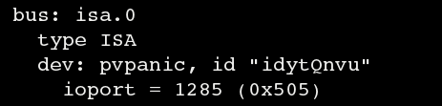
How To Use
1.Add the device when boot up guest:
-device pvpanic
2. check the device in “info qtree”
3. connect to qmp, and then ,in guest, issue “echo c > /proc/sysrq-trigger”
4. could see the event and the guset is paused.:
{"timestamp": {"seconds": 1451456194, "microseconds": 919139}, "event": "GUEST_PANICKED", "data": {"action": "pause"}}
{"timestamp": {"seconds": 1451456194, "microseconds": 922003}, "event": "STOP"}
Info status:
(qemu) info status
VM status: paused (guest-panicked)
NOTE:Since this feature is for libvirt “virsh dump”,so need to test this feature using libvirt

Slide 16
How To Use
the guest can notify the host once a guest panic has occurred, by sending an event to qemu, that in it's turn will notify Libvirt. Libvirt has controls for how it can react to such an event; either by
restarting or shunting down the guest.
Libvirt has a mechanism to automatically save guest crash dumps
to a dedicated location on a host /var/lib/libvirt/qemu/dump ,you can modify this path by edit /etc/libvirt/qemu.con → uto_dump_path= , you'd better change this path to a large partition

